Slide 1


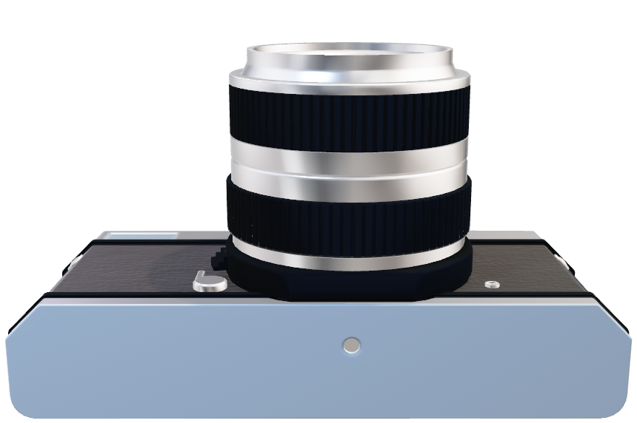
THE EXPOSURE TRI NGLE
PHOTOGRAPHY

Slide 2
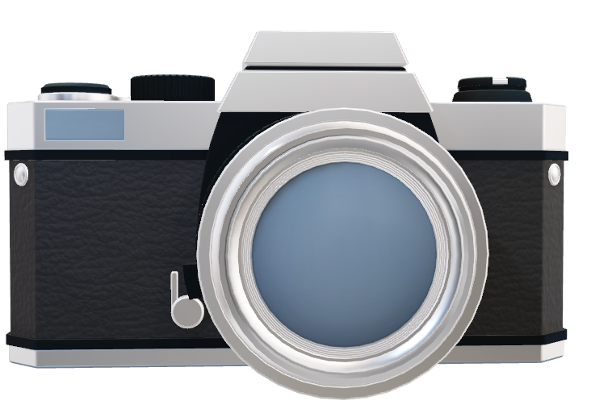
THE EXPOSURE TRI NGLE
PHOTOGRAPHY

Slide 3
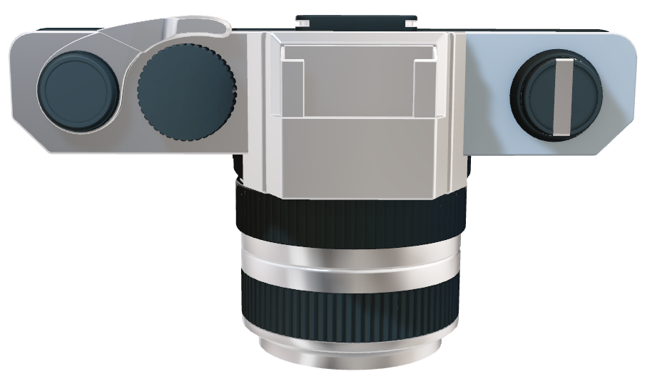
ISO
Aperture
Shutter Speed
THE EXPOSURE TRI NGLE
PHOTOGRAPHY
Notes:
ISO: It is a measure of the camera’s sensitivity to light. The lower the ISO number, the less sensitive the camera is to light, while a higher ISO number increases the camera’s sensitivity to light. However, increasing the ISO comes at a cost. As the ISO rises, so does the visibility of graininess/noise in your images ¹.
Aperture: It is a hole within a lens, through which light travels into the camera body. The larger the hole, the more light passes to the camera sensor. Aperture also controls the depth of field, which is the portion of a scene that appears to be sharp. If the aperture is very small, the depth of field is large, while if the aperture is large, the depth of field is small. In photography, aperture is typically expressed in “f” numbers (also known as “focal ratio”, since the f-number is the ratio of the diameter of the lens aperture to the length of the lens) ¹.
Shutter speed: It controls how long your camera’s sensor is exposed to light. Shutter speeds are typically measured in fractions of a second. Slow shutter speeds allow more light into the camera sensor and are used for low-light and night photography, while fast shutter speeds help to freeze motion ¹.

Slide 4



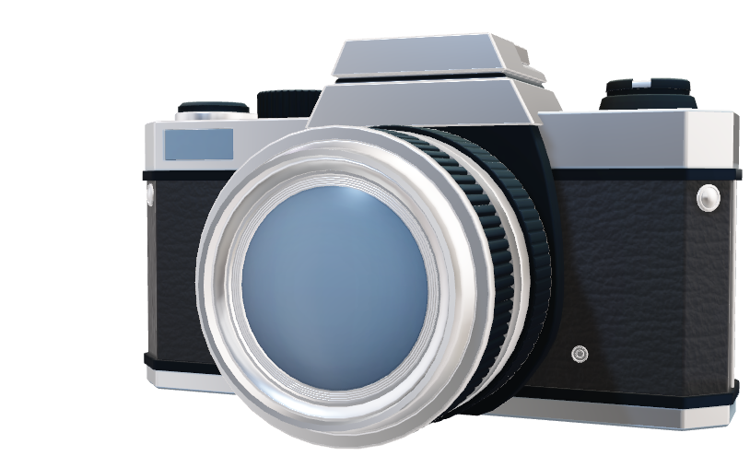
Aperture
Allows light to pass to the camera sensor
Shutter Speed
Controls camera’s sensor exposure to light
ISO
Measures camera sensitivity to light
FUZZY LOGIC CONTROL SYSTEM
Notes:
ISO: It is a measure of the camera’s sensitivity to light. The lower the ISO number, the less sensitive the camera is to light, while a higher ISO number increases the camera’s sensitivity to light. However, increasing the ISO comes at a cost. As the ISO rises, so does the visibility of graininess/noise in your images ¹.
Aperture: It is a hole within a lens, through which light travels into the camera body. The larger the hole, the more light passes to the camera sensor. Aperture also controls the depth of field, which is the portion of a scene that appears to be sharp. If the aperture is very small, the depth of field is large, while if the aperture is large, the depth of field is small. In photography, aperture is typically expressed in “f” numbers (also known as “focal ratio”, since the f-number is the ratio of the diameter of the lens aperture to the length of the lens) ¹.
Shutter speed: It controls how long your camera’s sensor is exposed to light. Shutter speeds are typically measured in fractions of a second. Slow shutter speeds allow more light into the camera sensor and are used for low-light and night photography, while fast shutter speeds help to freeze motion ¹.

Slide 5
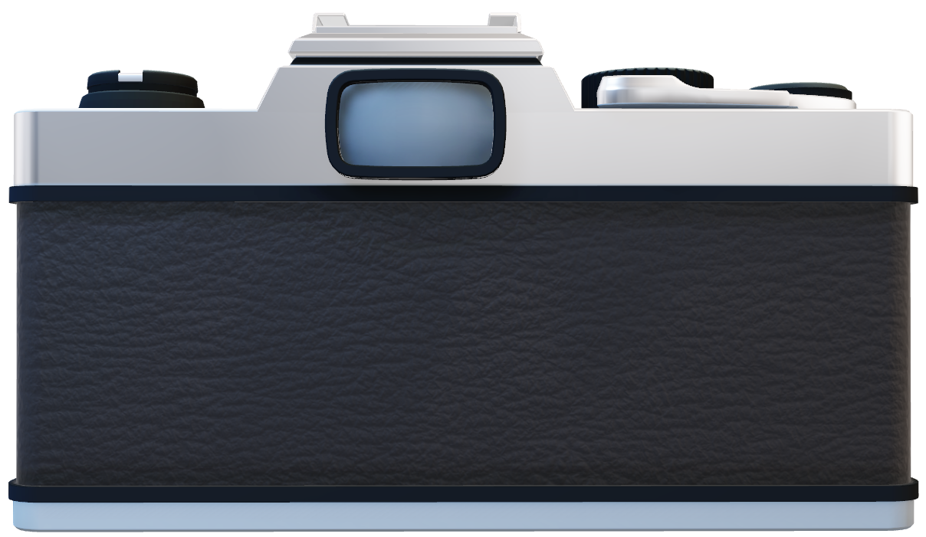
UNIVERSE OF DISCOURSE
FUZZY LOGIC CONTROL SYSTEM
Notes:
ISO: It is a measure of the camera’s sensitivity to light. The lower the ISO number, the less sensitive the camera is to light, while a higher ISO number increases the camera’s sensitivity to light. However, increasing the ISO comes at a cost. As the ISO rises, so does the visibility of graininess/noise in your images ¹.
Aperture: It is a hole within a lens, through which light travels into the camera body. The larger the hole, the more light passes to the camera sensor. Aperture also controls the depth of field, which is the portion of a scene that appears to be sharp. If the aperture is very small, the depth of field is large, while if the aperture is large, the depth of field is small. In photography, aperture is typically expressed in “f” numbers (also known as “focal ratio”, since the f-number is the ratio of the diameter of the lens aperture to the length of the lens) ¹.
Shutter speed: It controls how long your camera’s sensor is exposed to light. Shutter speeds are typically measured in fractions of a second. Slow shutter speeds allow more light into the camera sensor and are used for low-light and night photography, while fast shutter speeds help to freeze motion ¹.

Slide 6
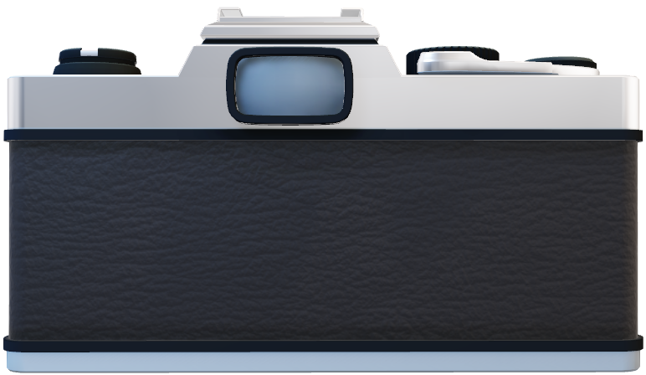
UNIVERSE OF DISCOURSE
Light Intensity | 1 to 10000
Aperture Value | 1 to 22
Shutter Speed | 1 to 30
ISO | 1 to 6400
FUZZY LOGIC CONTROL SYSTEM
Notes:
ISO: It is a measure of the camera’s sensitivity to light. The lower the ISO number, the less sensitive the camera is to light, while a higher ISO number increases the camera’s sensitivity to light. However, increasing the ISO comes at a cost. As the ISO rises, so does the visibility of graininess/noise in your images ¹.
Aperture: It is a hole within a lens, through which light travels into the camera body. The larger the hole, the more light passes to the camera sensor. Aperture also controls the depth of field, which is the portion of a scene that appears to be sharp. If the aperture is very small, the depth of field is large, while if the aperture is large, the depth of field is small. In photography, aperture is typically expressed in “f” numbers (also known as “focal ratio”, since the f-number is the ratio of the diameter of the lens aperture to the length of the lens) ¹.
Shutter speed: It controls how long your camera’s sensor is exposed to light. Shutter speeds are typically measured in fractions of a second. Slow shutter speeds allow more light into the camera sensor and are used for low-light and night photography, while fast shutter speeds help to freeze motion ¹.

Slide 7
LINGUISTIC VARIABLE
LIGHT INTENSITY
Dark | 0 to 3000
Dim | 2500 to 7000
Bright | 6000 to 10000
FUZZY LOGIC CONTROL SYSTEM
Notes:
ISO: It is a measure of the camera’s sensitivity to light. The lower the ISO number, the less sensitive the camera is to light, while a higher ISO number increases the camera’s sensitivity to light. However, increasing the ISO comes at a cost. As the ISO rises, so does the visibility of graininess/noise in your images ¹.
Aperture: It is a hole within a lens, through which light travels into the camera body. The larger the hole, the more light passes to the camera sensor. Aperture also controls the depth of field, which is the portion of a scene that appears to be sharp. If the aperture is very small, the depth of field is large, while if the aperture is large, the depth of field is small. In photography, aperture is typically expressed in “f” numbers (also known as “focal ratio”, since the f-number is the ratio of the diameter of the lens aperture to the length of the lens) ¹.
Shutter speed: It controls how long your camera’s sensor is exposed to light. Shutter speeds are typically measured in fractions of a second. Slow shutter speeds allow more light into the camera sensor and are used for low-light and night photography, while fast shutter speeds help to freeze motion ¹.

Slide 8
LINGUISTIC VARIABLE
APERTURE
Large | 0 to 4
Medium | 3 to 13
Small | 11 to 22
FUZZY LOGIC CONTROL SYSTEM
Notes:
ISO: It is a measure of the camera’s sensitivity to light. The lower the ISO number, the less sensitive the camera is to light, while a higher ISO number increases the camera’s sensitivity to light. However, increasing the ISO comes at a cost. As the ISO rises, so does the visibility of graininess/noise in your images ¹.
Aperture: It is a hole within a lens, through which light travels into the camera body. The larger the hole, the more light passes to the camera sensor. Aperture also controls the depth of field, which is the portion of a scene that appears to be sharp. If the aperture is very small, the depth of field is large, while if the aperture is large, the depth of field is small. In photography, aperture is typically expressed in “f” numbers (also known as “focal ratio”, since the f-number is the ratio of the diameter of the lens aperture to the length of the lens) ¹.
Shutter speed: It controls how long your camera’s sensor is exposed to light. Shutter speeds are typically measured in fractions of a second. Slow shutter speeds allow more light into the camera sensor and are used for low-light and night photography, while fast shutter speeds help to freeze motion ¹.

Slide 9
LINGUISTIC VARIABLE
SHUTTER SPEED
Fast | 0 to 3
Moderate | 1 to 15
Slow | 10 to 30
FUZZY LOGIC CONTROL SYSTEM
Notes:
ISO: It is a measure of the camera’s sensitivity to light. The lower the ISO number, the less sensitive the camera is to light, while a higher ISO number increases the camera’s sensitivity to light. However, increasing the ISO comes at a cost. As the ISO rises, so does the visibility of graininess/noise in your images ¹.
Aperture: It is a hole within a lens, through which light travels into the camera body. The larger the hole, the more light passes to the camera sensor. Aperture also controls the depth of field, which is the portion of a scene that appears to be sharp. If the aperture is very small, the depth of field is large, while if the aperture is large, the depth of field is small. In photography, aperture is typically expressed in “f” numbers (also known as “focal ratio”, since the f-number is the ratio of the diameter of the lens aperture to the length of the lens) ¹.
Shutter speed: It controls how long your camera’s sensor is exposed to light. Shutter speeds are typically measured in fractions of a second. Slow shutter speeds allow more light into the camera sensor and are used for low-light and night photography, while fast shutter speeds help to freeze motion ¹.

Slide 10
LINGUISTIC VARIABLE
ISO
Low | 0 to 1200
Medium | 700 to 3200
High | 2400 to 6400
FUZZY LOGIC CONTROL SYSTEM
Notes:
ISO: It is a measure of the camera’s sensitivity to light. The lower the ISO number, the less sensitive the camera is to light, while a higher ISO number increases the camera’s sensitivity to light. However, increasing the ISO comes at a cost. As the ISO rises, so does the visibility of graininess/noise in your images ¹.
Aperture: It is a hole within a lens, through which light travels into the camera body. The larger the hole, the more light passes to the camera sensor. Aperture also controls the depth of field, which is the portion of a scene that appears to be sharp. If the aperture is very small, the depth of field is large, while if the aperture is large, the depth of field is small. In photography, aperture is typically expressed in “f” numbers (also known as “focal ratio”, since the f-number is the ratio of the diameter of the lens aperture to the length of the lens) ¹.
Shutter speed: It controls how long your camera’s sensor is exposed to light. Shutter speeds are typically measured in fractions of a second. Slow shutter speeds allow more light into the camera sensor and are used for low-light and night photography, while fast shutter speeds help to freeze motion ¹.

